Slide 1
Introducción a Python
(guía rápida para turistas)

Slide 2
¿Quién soy?
Jose Rodriguez Bas
CTO en ECI Reparaciones S.L.
“Trasteo con la tecnología”
silverdisc@gmail.com github.com/aezore @aezore

Slide 3

Python

Slide 4
¿QUÉ ES PYTHON?

Slide 5
INTERPRETADO

Slide 6
INTERPRETADO
DINÁMICO

Slide 7
INTERPRETADO
DINÁMICO
MULTIPLATAFORMA

Slide 8
un anillo para gobernarlos a todos
Jython
Cython
PyPy
IronPython
Stackless Python
MicroPython
y atarlos en las tinieblas…
Notes:
JPMorgan y CCPGames (EVE Online) usan Stackless Python

Slide 9
¿quién…?
JP Morgan
Blender
CCPGames (EVE Online)
Spotify
Instagram
Youtube
Dropbox
Machine Learning & IA
Data Science
Web Scrapping
etc…

Slide 10
MULTIPARADIGMA

Slide 11
IMPERATIVO
PARTIALS
CLOSURES
DEFAULTS

Slide 12
OOP
HERENCIA MÚLTIPLE
CLASES ABSTRACTAS
“DATACLASSES”

Slide 13
FUNCIONAL
map()
reduce()
filter()
lambdas

Slide 14
EXTENSIBLE

Slide 15
365,450
proyectos en el repositorio pypi.org

Slide 16
$> pip install flask

Slide 17
$> python ./script.py

Slide 18
$> python
[silverdisc@hp ~]$ python
Python 3.10.2 (main, Jan 15 2022, 19:56:27) [GCC 11.1.0] on linux
Type "help", "copyright", "credits" or "license" for more information.
>>> print("Hola Mundo")
Hola Mundo
>>>

Slide 19
virtual envs
$> pipenv lock

Slide 20
import

Slide 21
import
import sys
import numpy as np
from pandas import DataFrame
version = sys.version
arr = np.array([20,30,40,50])
df = DataFrame.from_dict(...)

Slide 22
import this

Slide 23
import this
import this
The Zen of Python, by Tim Peters
Beautiful is better than ugly.
Explicit is better than implicit.
Simple is better than complex.
Complex is better than complicated.
Flat is better than nested.
Sparse is better than dense.
Readability counts.
Special cases aren't special enough to break the rules.
Although practicality beats purity.
Errors should never pass silently.
Unless explicitly silenced.
In the face of ambiguity, refuse the temptation to guess.
There should be one-- and preferably only one --obvious way to do it.
Although that way may not be obvious at first unless you're Dutch.
Now is better than never.
Although never is often better than *right* now.
If the implementation is hard to explain, it's a bad idea.
If the implementation is easy to explain, it may be a good idea.
Namespaces are one honking great idea -- let's do more of those!

Slide 24
import this
import this
The Zen of Python, by Tim Peters
Beautiful is better than ugly.
Explicit is better than implicit.
Simple is better than complex.
Complex is better than complicated.
Flat is better than nested.
Sparse is better than dense.
Readability counts.
Special cases aren't special enough to break the rules.
Although practicality beats purity.
Errors should never pass silently.
Unless explicitly silenced.
In the face of ambiguity, refuse the temptation to guess.
There should be one-- and preferably only one --obvious way to do it.
Although that way may not be obvious at first unless you're Dutch.
Now is better than never.
Although never is often better than *right* now.
If the implementation is hard to explain, it's a bad idea.
If the implementation is easy to explain, it may be a good idea.
Namespaces are one honking great idea -- let's do more of those!
Simple es mejor que complejo.
La legibilidad es importante.
Si la implementación es difícil de explicar, es una mala idea.

Slide 25
PEPs
(Python Enhancement Proposals)

Slide 26
PEP8
(guía “oficial” de estilo)

Slide 27
PEP8
# Alineado a la apertura del delimitador.
foo = long_function_name(var_one, var_two,
var_three, var_four)
# Añade 4 espacios extra para distinguir argumentos del resto.
def long_function_name(
var_one, var_two, var_three,
var_four):
print(var_one)
# La indentaciones colgantes deben añadir un nivel.
foo = long_function_name(
var_one, var_two,
var_three, var_four)

Slide 28
black
autopep8
yapf

Slide 29
todo es un objeto
(casi todo)

Slide 30
tipos y estructuras
un vistazo rápido

Slide 31
TIPOS DE DATOS Y ESTRUCTURAS
Números
numero = 100
numero_grande = 100_000_000
flotante = 2.99
exponente = 10e-20
complejo = 1+3j

Slide 32
TIPOS DE DATOS Y ESTRUCTURAS
Números
Strings
fruta = "pomelo"
fruta.upper() → POMELO
fruta.capitalize() → Pomelo
fruta.isdigit() → False

Slide 33
TIPOS DE DATOS Y ESTRUCTURAS
lista = [1,"dos",["tres", "Gianluca"]]
tupla = ("Jose", "Eva")
>>> lista[1]
'dos'
>>> lista[:]
[1, 'dos', ['tres', 'Gianluca']]
>>> lista[:-1]
[1, 'dos']
>>> lista[-1:]
[['tres', 'Gianluca']]
>>> lista[::-1]
[['tres', 'Gianluca'], 'dos', 1]
numeros = [4,13,94,183492,913884,2]
numeros.sort() -> [2, 4, 13, 94, 183492, 913884]
Números
Strings
Listas / Tuplas

Slide 34
TIPOS DE DATOS Y ESTRUCTURAS
Números
Strings
Listas
Diccionarios
>>> dic = {1:200, "nombre": "Jose", "switch" : lista}
>>> dic.values()
dict_values([200, 'Jose', [1, 'dos', ['tres', 'Gianluca']]])
>>> dic.keys()
dict_keys([1, 'nombre', 'switch'])
>>> dic.items()
dict_items([(1, 200), ('nombre', 'Jose'), ('switch', [1, 'dos', ['tres', 'Gianluca']])])
>>> dic["nombre"]
'Jose'

Slide 35
TIPOS DE DATOS Y ESTRUCTURAS
Números
Strings
Listas
Diccionarios
Sets
s = {1,2,'tres',"VBCoding"}
>>> lista = [1,2,2,3,3,4,5,6,7,7,8]
>>> set(lista)
{1, 2, 3, 4, 5, 6, 7, 8}

Slide 36
TIPOS DE DATOS Y ESTRUCTURAS
Números
Strings
Listas
Diccionarios
Sets
Deques
>>> from collections import deque
>>>
>>> d = deque('abc')
>>> d.extendleft('123')
>>> d.rotate(1)
>>> d.pop()
'b'
>>> d
deque(['c', '3', '2', '1', 'a'])

Slide 37
Desempaquetado de iterables / desestructuración
>>> fruta = ["pera", "manzana"]
>>> pera, manzana = fruta
>>> pera
'pera'
>>> manzana
'manzana'

Slide 38
IDIOMÁTICO
legibilidad por delante

Slide 39
Java vs Python
public class PrintOS
{
public static void main(final String[] args)
{
String osName = System.getProperty("os.name") ;
if (osName.equals("SunOS") || osName.equals("Linux"))
{
System.out.println("This is a UNIX box and therefore good.") ;
}
else if (osName.equals("Windows NT") || osName.equals("Windows 95"))
{
System.out.println("This is a Windows box and therefore bad.") ;
}
else
{
System.out.println("This is not a box.") ;
}
}
}

Slide 40
Java vs Python
import os
def PrintOS():
if os.name == "SunOS" or os.name == "Linux":
print("This is a UNIX box and therefore good.")
elif os.name == "Windows NT" or os.name == "Windows 95":
print("This is a Windows box and therefore bad.")
else:
print("This is not a box.")
import os
def PrintOS():
linux = ("SunOS","Linux")
windows = ("Windows NT", "Windows 95")
if os.name in linux:
print("This is a UNIX box and herefore good.")
elif os.name in windows:
print("This is a Windows box and erefore bd.")
else:
print("This is not a box.")

Slide 41
for “each” loops

Slide 42
for loops
nombres = ["pichu","estiben","gianluca"]
mayusculas = []
for i in range(len(nombres)):
mayusculas.append(nombres[i].upper())
>>> ['PICHU', 'ESTIBEN', 'GIANLUCA']

Slide 43
for loops
nombres = ["pichu","estiben","gianluca"]
mayusculas = []
for nombre in nombres:
mayusculas.append(nombre.upper())
>>> ['PICHU', 'ESTIBEN', 'GIANLUCA']

Slide 44
list comprehensions

Slide 45
LIST COMPREHENSIONS
colores = ["rojo", "amarillo", "verde"]
mayusculas = []
for color in colores:
mayusculas.append(color.upper())
['ROJO', 'AMARILLO', 'VERDE']

Slide 46
LIST COMPREHENSIONS
colores = ["rojo", "amarillo", "verde"]
mayusculas = [color.upper() for color in colores]
['ROJO', ‘AMARILLO’, 'VERDE']

Slide 47
zip()

Slide 48
zip()
colores = ["rojo", "amarillo", "verde"]
frutas = ["manzana", "platano", "pera"]
for color, fruta in zip(colores, frutas):
print(f"La {fruta} es {color}")
La manzana es rojo
La platano es amarillo
La pera es verde
mayusculas = [ [color.upper(), fruta.upper()] for color, fruta in zip(colores, frutas)]
[['ROJO', 'MANZANA'], ['AMARILLO', 'PLATANO'], ['VERDE', 'PERA']]

Slide 49
f”strings”
f”Esto es una cadena y {esto} es una variable”

Slide 50
“f” strings
>>> nombre = "Estiben"
>>> edad = "muchos"
>>> f"{nombre} tiene {edad.upper()} años"
'Estiben tiene MUCHOS años'

Slide 51
“f” strings
>>> nombre = "Estiben"
>>> edad = "muchos"
>>> f"{nombre} tiene {edad.upper()} años"
'Estiben tiene MUCHOS años'
>>> diccionario = {'nombre' : "Estiben", 'edad' : 39}
>>> F"{diccionario['nombre']} tiene {diccionario['edad'] + 1} años"
'Estiben tiene 40 años'

Slide 52
“f” strings
>>> nombre = "Estiben"
>>> edad = "muchos"
>>> f"{nombre} tiene {edad.upper()} años"
'Estiben tiene MUCHOS años'
>>> diccionario = {'nombre' : "Estiben", 'edad' : 39}
>>> f"{diccionario['nombre']} tiene {diccionario['edad'] + 1} años"
'Estiben tiene 40 años'
>>> debe = 100
>>> haber = 65000
>>> f"DEBE:{debe:>7}€ / HABER:{haber:>7}€"
'DEBE: 100€ / HABER: 65000€'
>>> f"{debe=}"
'debe=100'

Slide 53
context managers
with func() as alias:

Slide 54
context managers
>>> linea = "Esto es un texto"
>>> with open("texto.txt", 'w') as archivo:
... archivo.write(linea)
16
>>> with open("texto.txt", 'r') as archivo2:
... print( archivo2.readlines() )
['Esto es un texto']

Slide 55
generadores
return → yield

Slide 56
Excepciones
raise
try:
x = input("Introduce un número: ")
x = x + 1
print(x)
except TypeError:
print("Sólo números")
numero = "uno"
if type(numero) is str:
raise TypeError

Slide 57
type hints:
pistas de tipado

Slide 58
type hints
tiempo: str = "lluvioso"
grados: int # puedes declarar antes de usar
grados = 18

Slide 59
type hints
tiempo: str = "lluvioso"
grados: int # puedes declarar antes de usar
grados = 18
def suma(a: int, b: int):
return a + b

Slide 60
type hints
tiempo: str = "lluvioso"
grados: int # puedes declarar antes de usar
grados = 18
def suma(a: int, b: int):
return a + b
def suma(numero1, numero2) -> int :
return numero1 + numero2

Slide 61

type hints
tiempo: str = "lluvioso"
grados: int
grados = 18
def suma(a: int, b: int):
return a + b
def suma(numero1, numero2) -> int :
return numero1 + numero2

Slide 62
asyncio()
async / await

Slide 63
multithreading
import threading

Slide 64

Jupyter / IPython

Slide 65
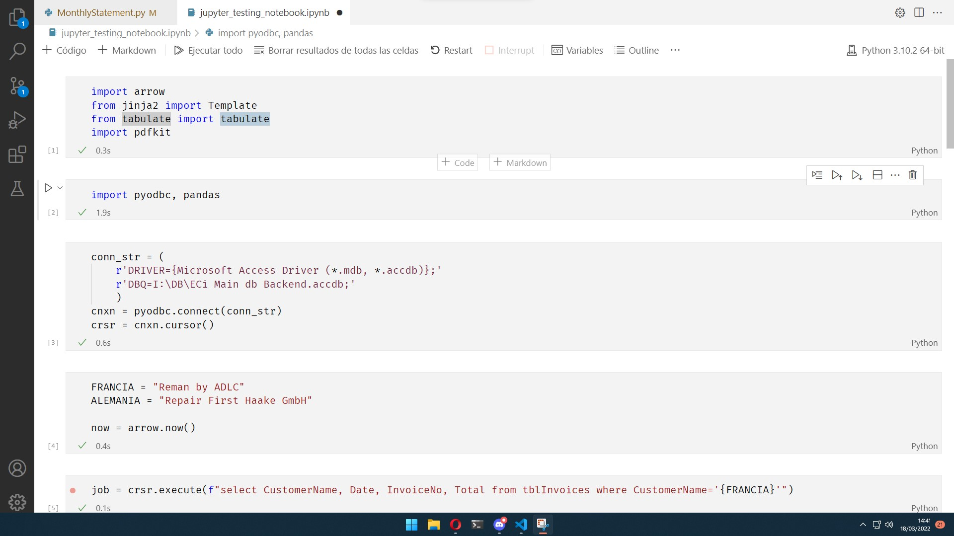

Slide 66
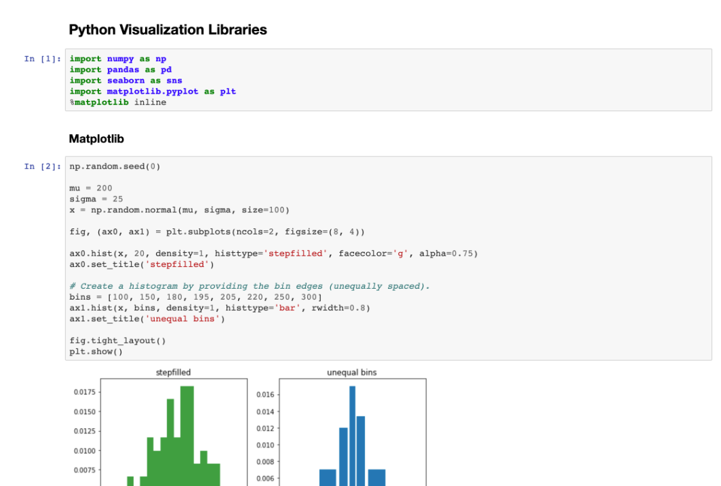

Slide 67
Jupyter / IPython
MAGIC WORDS
%timeit for _ in range(100): True
1.33 µs ± 11.3 ns per loop (mean ± std. dev. of 7 runs, 1,000,000 loops each)

Slide 68
Una pequeña selección…
PANDAS
“Data Science” y manipulación de datos
NUMPY
Computación numérica con extensiones en C
BEAUTIFUL SOUP
Web Scrapping
HTML / XML Parser
FASTAPI
Web Framework para creación de APIs de alto rendimiento
TENSORFLOW
Machine Learning
PYSIMPLEGUI
Creación de interfaces gráficas

Slide 69
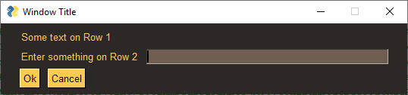
PySimpleGui
import PySimpleGUI as sg
sg.theme('DarkAmber') # Add a touch of color
# All the stuff inside your window.
layout = [ [sg.Text('Some text on Row 1')],
[sg.Text('Enter something on Row 2'), sg.InputText()],
[sg.Button('Ok'), sg.Button('Cancel')] ]
# Create the Window
window = sg.Window('Window Title', layout)
while True:
event, values = window.read()
if event == sg.WIN_CLOSED or event == 'Cancel':
break
print('You entered ', values[0])
window.close()

Slide 70
Arrow
>>> utc = arrow.utcnow()
<Arrow [2013-05-11T21:23:58.970460+00:00]>
>>> utc.shift(hours=-1)
<Arrow [2013-05-11T20:23:58.970460+00:00]>
>>> local.format()
'2013-05-11 13:23:58 -07:00'
>>> local.format('YYYY-MM-DD HH:mm:ss ZZ')
'2013-05-11 13:23:58 -07:00'
>>> local.humanize()
'an hour ago'
>>> local.humanize(locale='ko-kr')
'한시간 전'

Slide 71

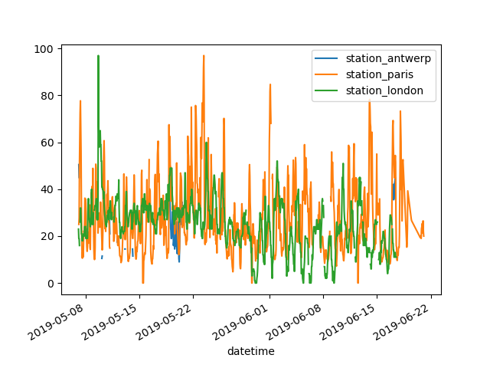
In [1]: import pandas as pd
In [2]: import matplotlib.pyplot as plt
In [3]: air_quality = pd.read_csv("data/air_quality_no2.csv", index_col=0, parse_dates=True)
In [4]: air_quality.head()
Out[4]:
station_antwerp station_paris station_london
datetime
2019-05-07 02:00:00 NaN NaN 23.0
2019-05-07 03:00:00 50.5 25.0 19.0
2019-05-07 04:00:00 45.0 27.7 19.0
2019-05-07 05:00:00 NaN 50.4 16.0
2019-05-07 06:00:00 NaN 61.9 NaN
In [5]: air_quality.plot()
Out[5]: <AxesSubplot:xlabel='datetime'>

Slide 72
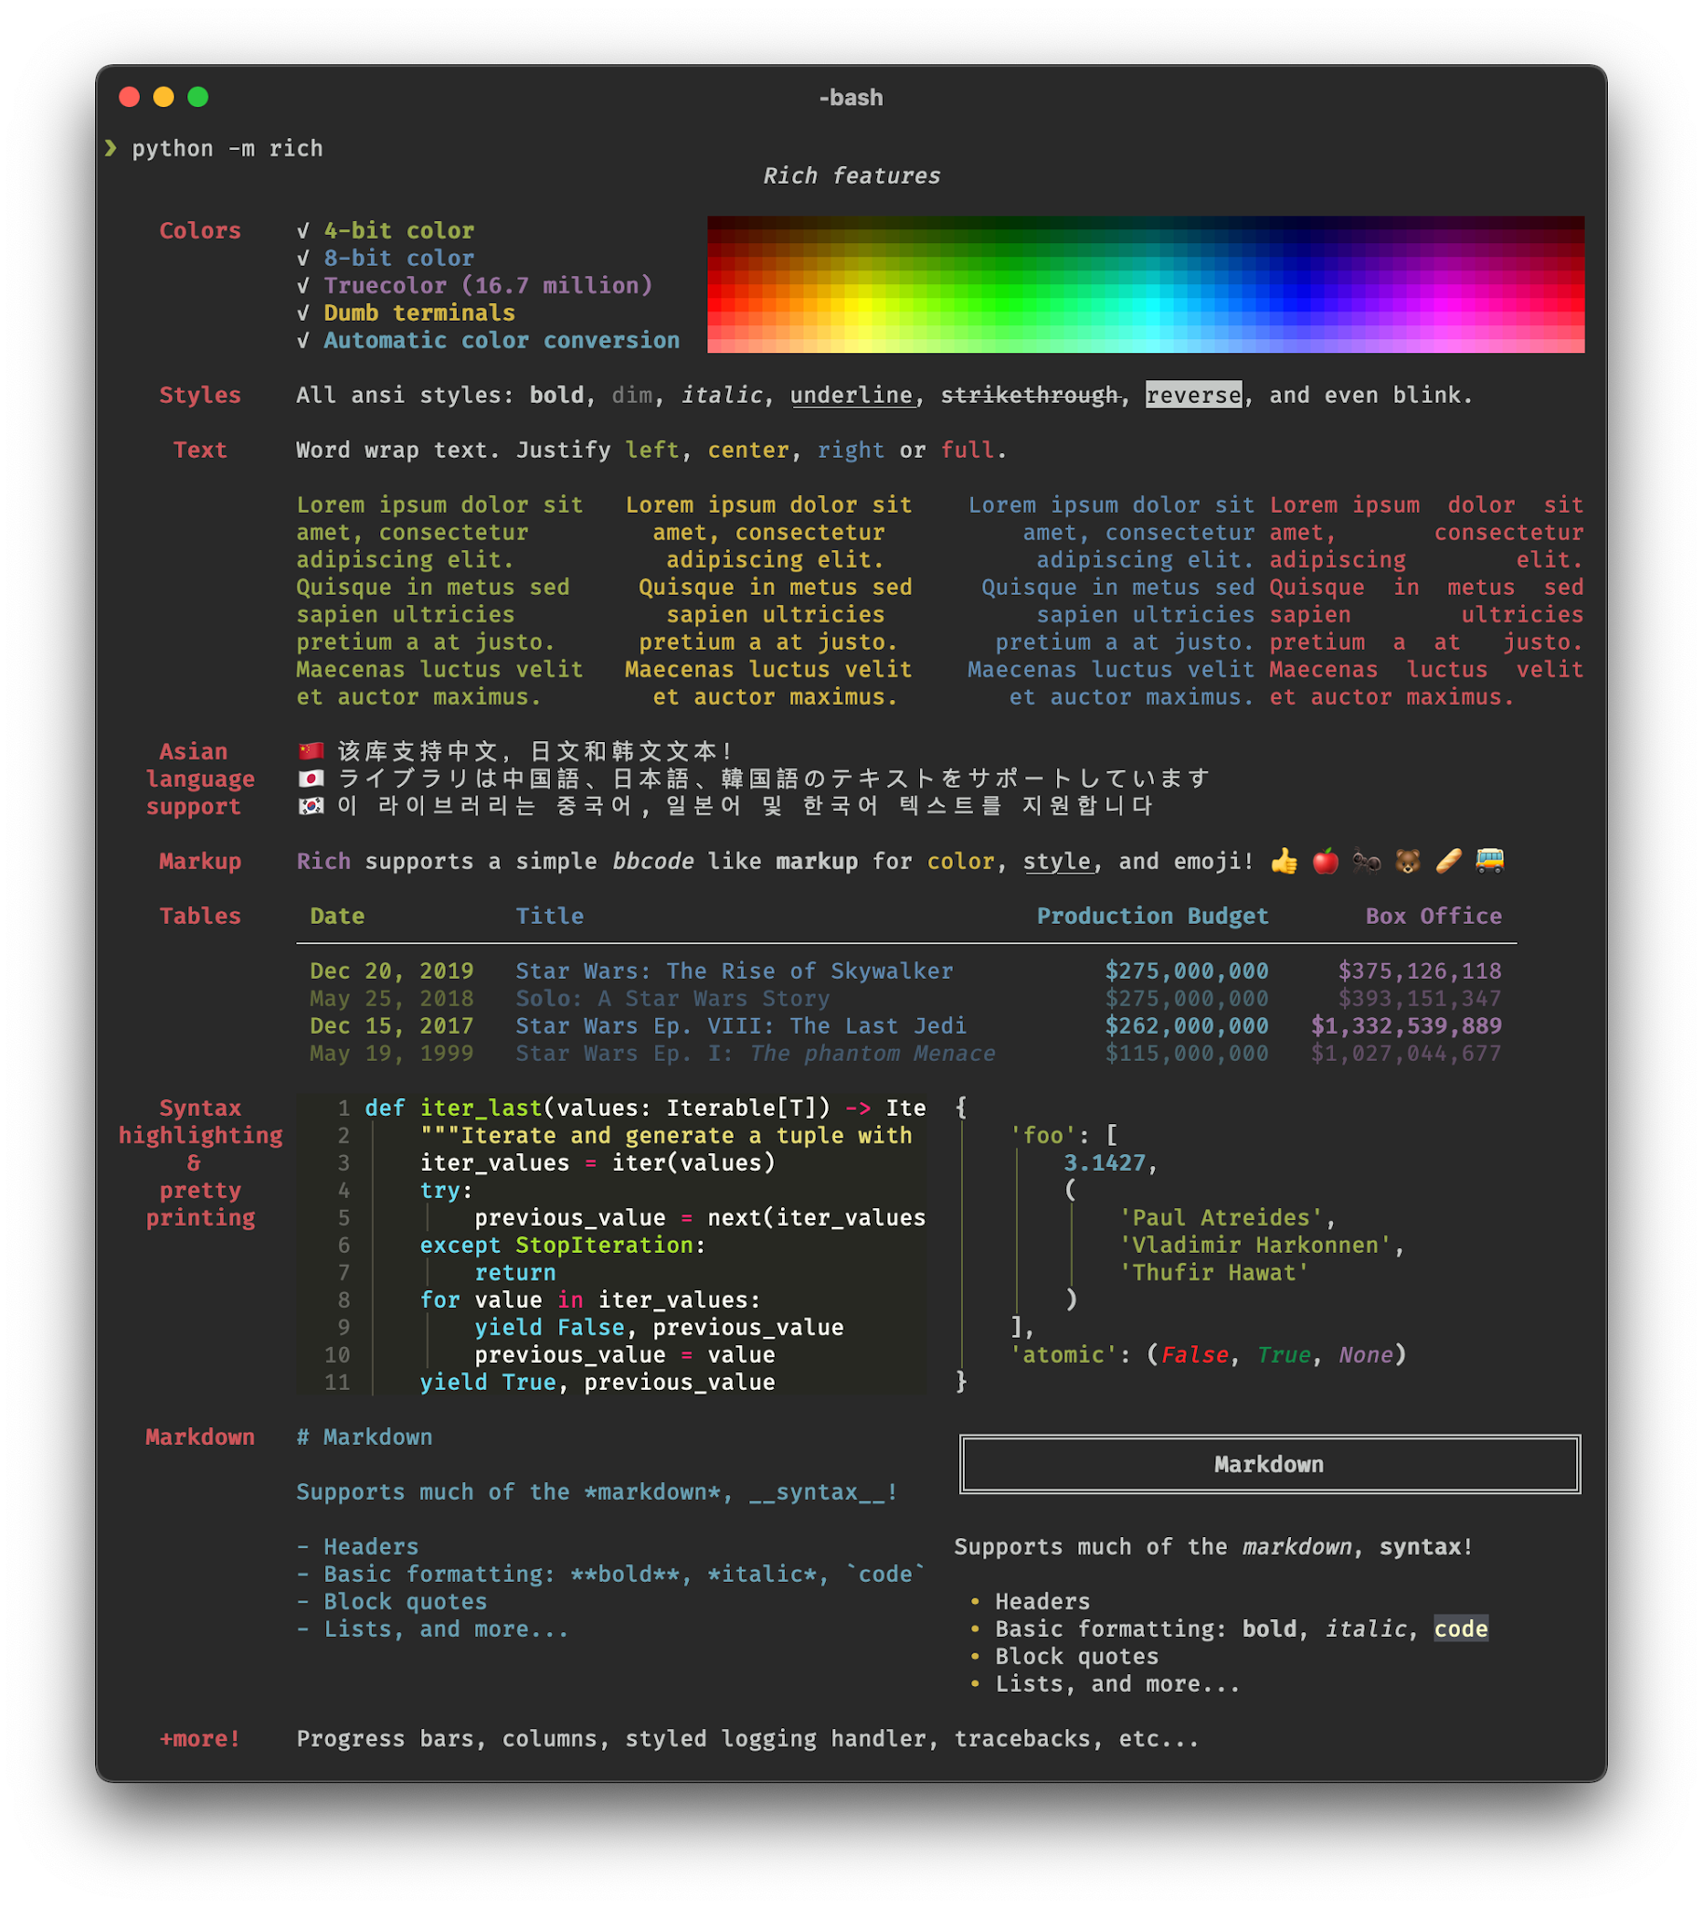
RICH

Slide 73
RICH
MARKDOWN = """
# This is an h1
Rich can do a pretty *decent* job of rendering markdown.
1. This is a list item
2. This is another list item
"""
from rich.console import Console
from rich.markdown import Markdown
console = Console()
md = Markdown(MARKDOWN)
console.print(md)
╔═══════════════════════════════════════════════════════════════════════════════════════════╗
║ This is an h1 ║
╚═══════════════════════════════════════════════════════════════════════════════════════════╝
Rich can do a pretty decent job of rendering markdown.
1 This is a list item
2 This is another list item

Slide 74
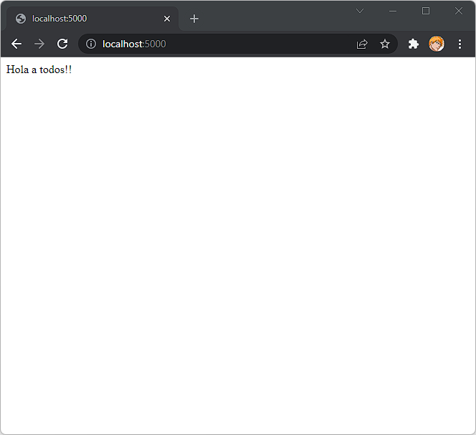
Flask
from flask import Flask
app = Flask(__name__)
@app.route("/")
def hello_world():
return "<p>Hola a todos!</p>"

Slide 75
Flask
from flask import Flask
app = Flask(__name__)
@app.route("/")
def hello_world():
return "<p>Hola a todos!</p>"
@app.route('/user/<username>', METHOD=”GET”)
def show_user_profile(username):
# show the user profile for that user
return f'User {username}'
@app.route('/post/<int:post_id>')
def show_post(post_id):
# show the post with the given id
return f'Post {post_id}'

Slide 76
django
Disqus Instagram Knight Foundation
MacArthur Foundation Mozilla National Geographic
Open Knowledge Foundation Pinterest Open Stack

Slide 77
Jinja
from jinja2 import Template
dic = {"nombre": "Eva", "charla": "VBCoding"}
with open("plantilla.html", "r") as archivo:
plantilla = archivo.read()
with open("resultado.html", "w") as archivo:
t = Template(plantilla)
archivo.write(t.render(dic))
<!DOCTYPE html>
<h1>Hola {{ nombre }}!!</h1>
<h2>Bienvenida a {{ charla }}</h2>
</html>
Hola Eva!!
Bienvenida a VBCoding

Slide 78

UNIR PDFS
import pathlib
import sys
import PyPDF2
def PDFmerge(pdfs, output):
pdfMerger = PyPDF2.PdfFileMerger()
for pdf in pdfs:
pdfMerger.append(str(pdf))
with open(output, "wb") as f:
pdfMerger.write(f)
def main():
path = pathlib.Path(sys.argv[1])
pdfs = path.rglob("*.pdf")
output = f"combined_{path.name}.pdf"
PDFmerge(pdfs=pdfs, output=output)
if __name__ == "__main__":
main()
35 Lineas (24 sloc)
685 bytes
30’ de desarrollo

Slide 79
EXTRACTOS MENSUALES
<html>
<p class="c5"><span class="c6">MONTHLY STATEMENT</span></p>
<p class="c5"><span class="c6">{{ last_month.format("MMMM YYYY") }}</span></p>
<p class="c0"><span class="c2">{{ cliente }}</span></p>
<p class="c0"><span class="c10">Invoices</span></p>
<p class="c12"><span class="c4">{{ invoices }}</span></p>
<p class="c1"><span class="c11">TOTAL INVOICED: {{ total_invoiced}}</span></p>
<p class="c0"><span class="c10">Credits</span></p>
<p class="c12"><span class="c4">{{ credits }}</span></p>
<p class="c1"><span class="c4">TOTAL CREDITED: {{ total_credited }}</span></p>
<p class="c1"><span class="c3">TOTAL STATEMENT: {{ total_statement }}</span></p>
</html>

Slide 80
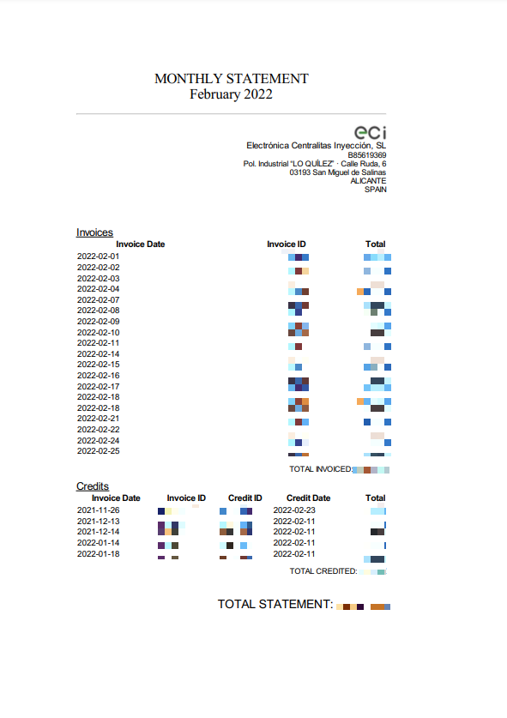
EXTRACTOS MENSUALES

Slide 81
¿PREGUNTAS?

Slide 82
CIAO!

